Slide 1

TPVision ASTA TV Architecture
陈钟龙 zhonglong.chen@tpv-tech.com
2014-3-13

Slide 2
目录
Android TV Architecture
Broadcast Architecture
TV Content Provider & TV Server
Reference

Slide 3
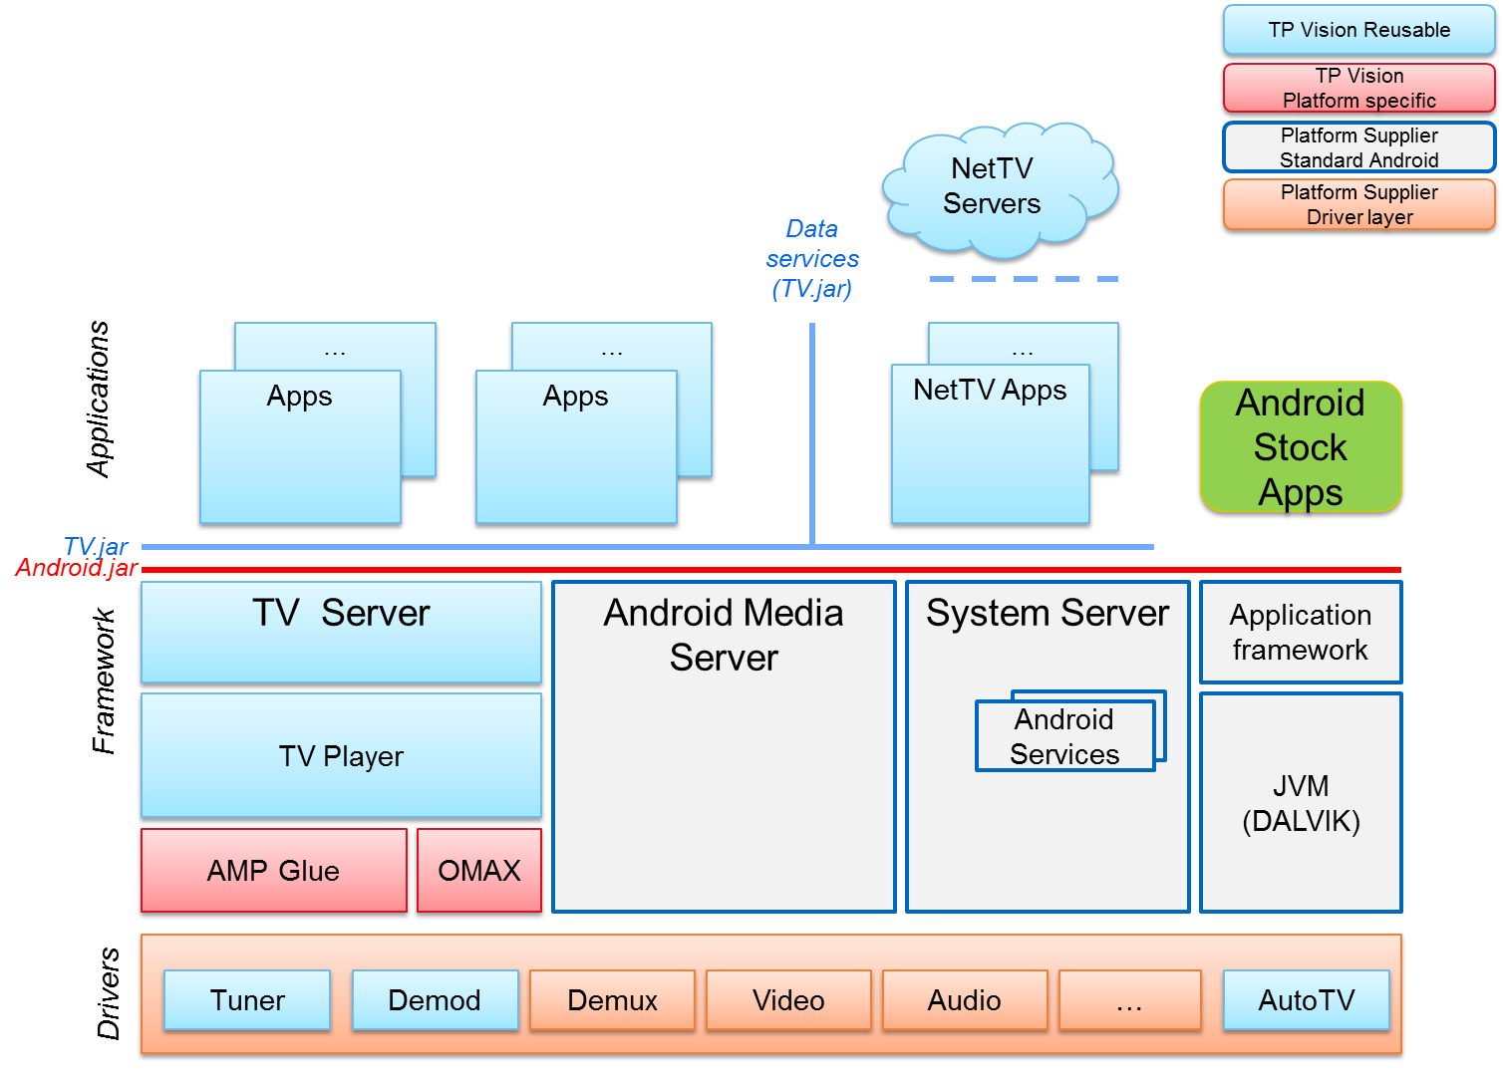
Android TV Architecture
ASTA：ASTA是TPVision提供的，主要包含TV stack的一套中间件，通过tv.jar进行调用。

Slide 4
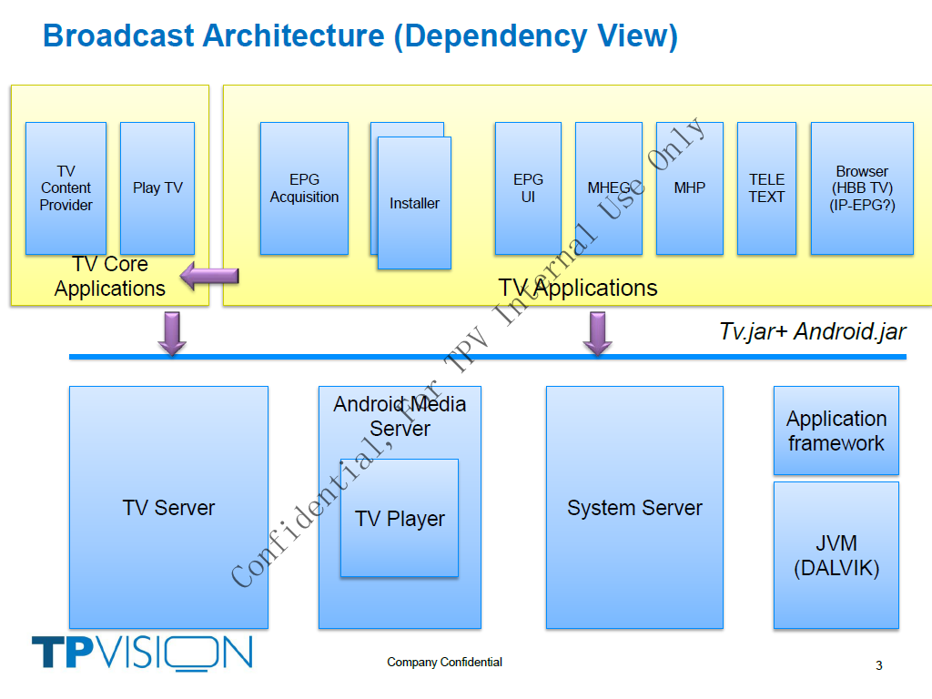
Broadcast Architecture

Slide 5
名词解释
EPG：电子节目单，包括Broadcast EPG和IP EPG
Installer：搜索频道
TeleText：图文电视
DVB：Digital Video Broadcasting
MHEG：Multimedia and Hypermedia Experts Group
MHP：Multimedia Home Platform
Hbb TV：Hybrid Broadcast Broadband TV

Slide 6
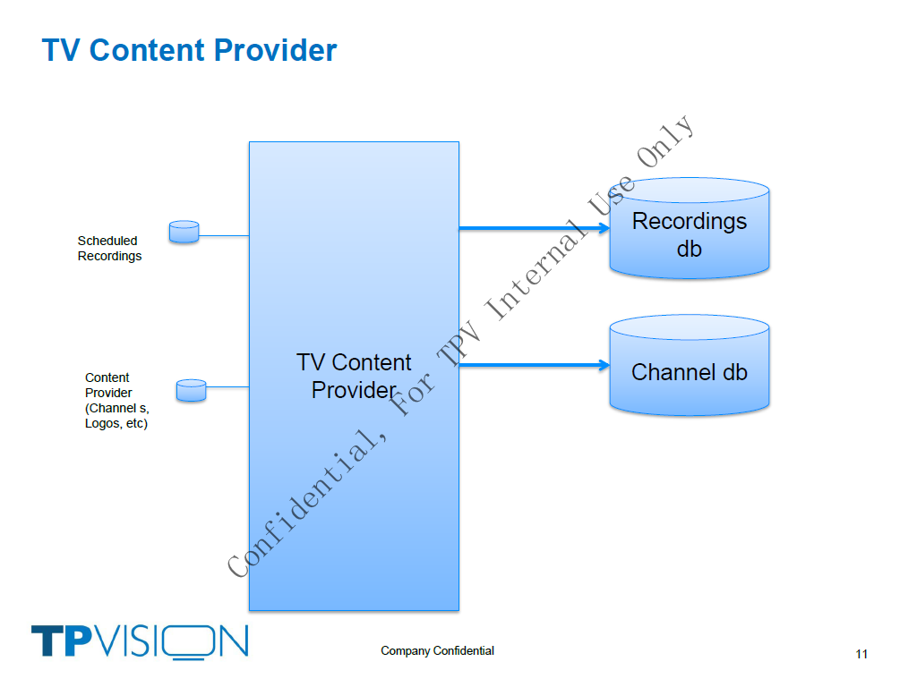
TV Content Provider

Slide 7
TV Content Provider
tv.jar, org.droidtv.tv.provider
Such as (refer to Dashboard & PlayTV): Source list: content://org.droidtv.tvcontentprovider.source Channel list: content://org.droidtv.tvcontentprovider.terrestrial content://org.droidtv.tvcontentprovider.cable EPG: content://org.droidtv.epgdvb

Slide 8
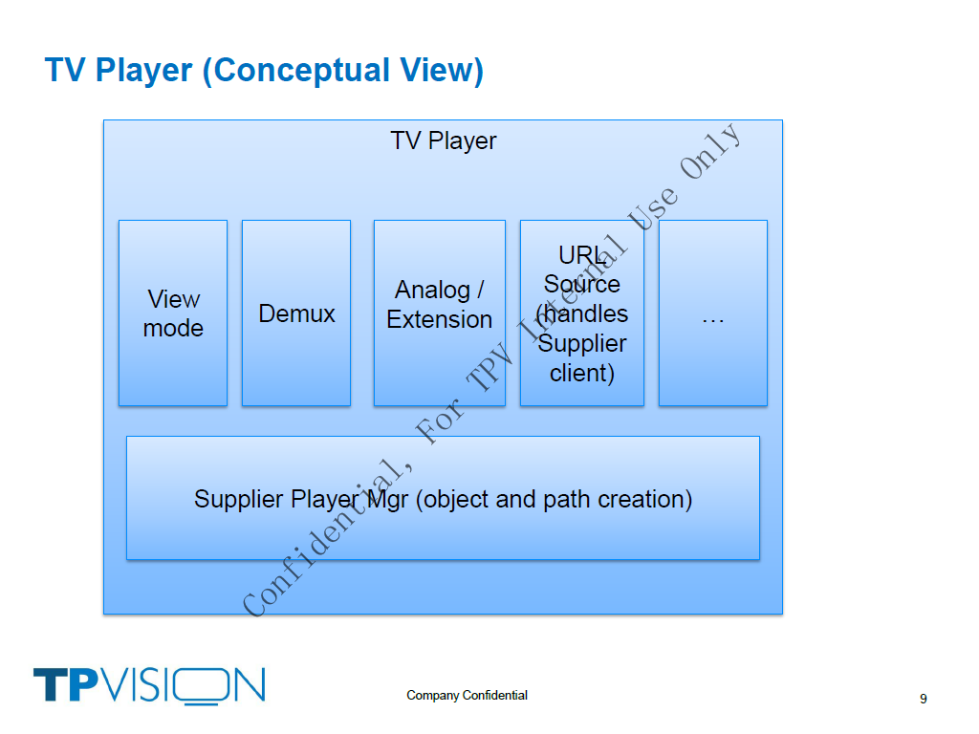
TV Player

Slide 9
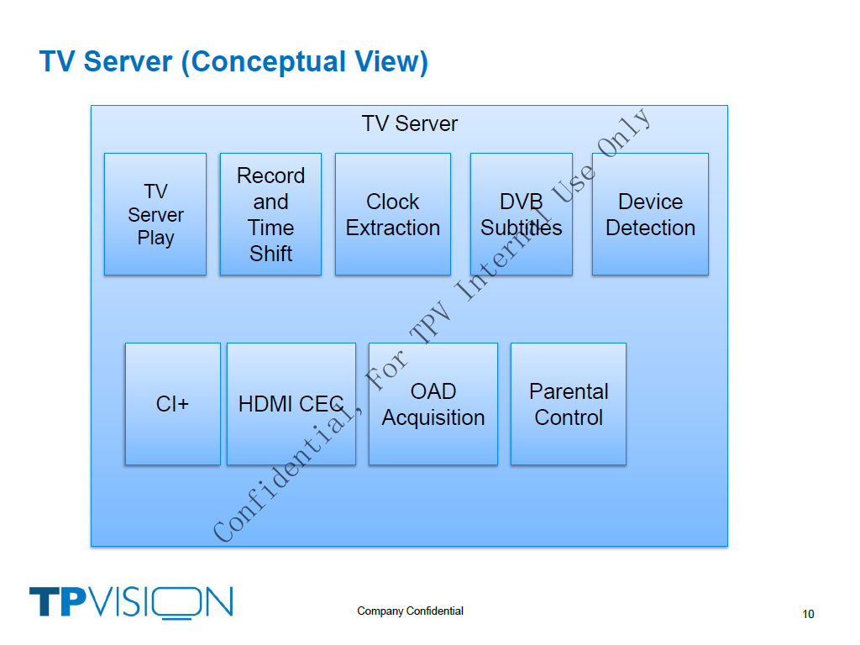
TV Server

Slide 10
TV Server
tv.jar, org.droidtv.tv
Such as (refer to Setting): TvSettingsManager TvVideoManager：图像设置 TvAudioManager：声音设置 TvClockManager：时钟设置

Slide 11
Applications
Dashboard -> Launcher
QSB -> UniSearch
settings
eum -> Help
Installer -> Setting (channel setup)
playtv
EPG
contentexplorer -> MediaCenter

Slide 12
Reference
Global SW architecture Android TV
Broadcast Architecture
Application: Dashboard, PlayTV & Setting
Wikipedia: http://en.wikipedia.org/wiki/Digital_Video_Broadcasting

Slide 13
Thank you!

